Slide 1
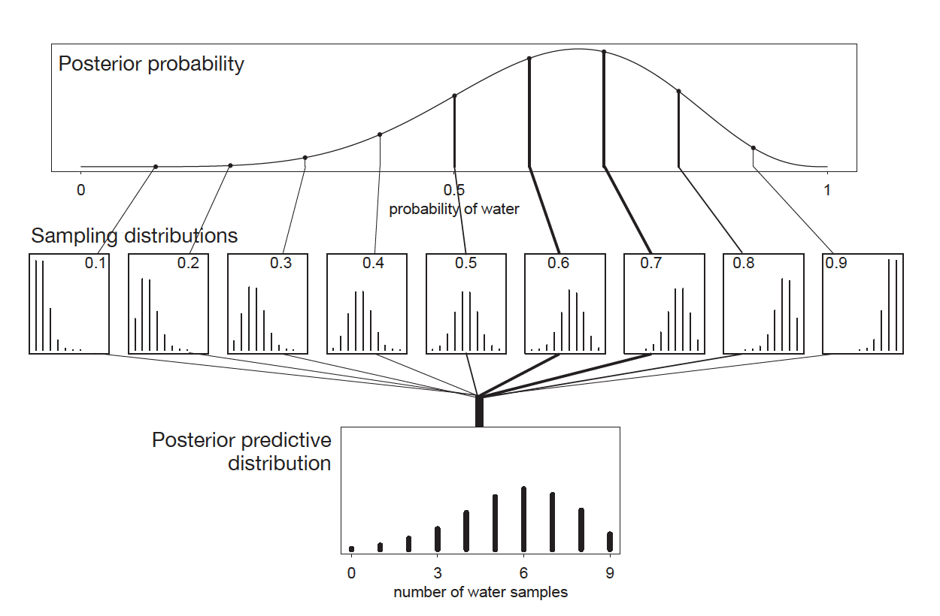
Recap Propagating uncertainty about parameter estimates to make predictions about the observations

Slide 2
The Modeling-Prediction Workflow
Data
Raw observations
Model-Based Predictions
On same scale as raw data
Model Fitting
Use probability density or mass functions (i.e., dnorm) to define the likelihood. Define priors. Generate posterior distributions
Prediction Generation
Use random generation functions (i.e., rnorm) and posterior samples to, in a sense, run the model in reverse
Statistical Model
Inference about model parameters made by examining the posteriors and summarizing posterior samples

Slide 3
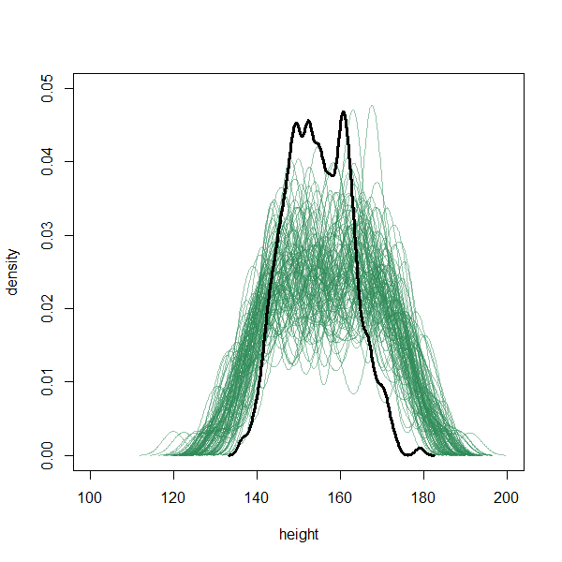
Why make predictions?
Simulate replications of the data
Forecast new observations
Predict outcomes for unobserved combinations of independent variables

Slide 4
Introduction to Statistics for Ecology and Evolutionary Biology Gaussian Regression Models Week 09 8 November 2021

Slide 5
Gaussian Models
Attempt to learn about the mean and variance of some (continuous) measurement
Estimate the mean by using an additive combination of other measurement variables
Simple, flexible, and commonly used, though not universally useful, it provides the foundation for many other types of models.

Slide 6

Normal Distribution
A continuous probability distribution with two parameters:
$μ$ = mean, $σ$ = standard deviation (or $σ2$ = variance)
Outcome is a real number (x) distributed according to a mean of $μ$ and a variance of $σ2$

Slide 7
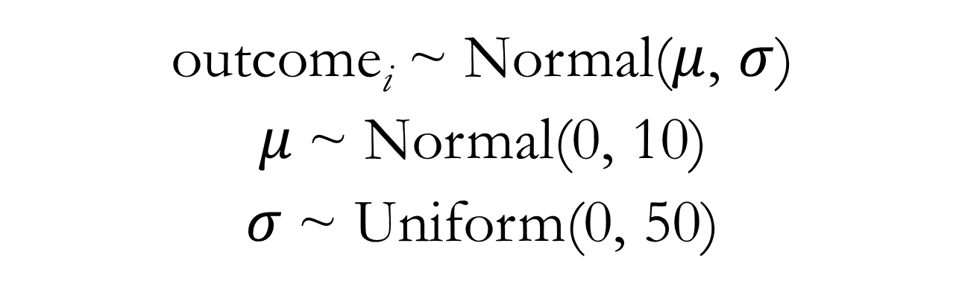
Models in Mathematical Language
outcome_{i} ~ Normal($μ$, $σ$)
$μ$~ Normal(0, 10)
$σ$~ Uniform(0, 50)

Slide 8
Models in Mathematical Language
Fits the outcome variable to the likelihood function
outcome_{i} ~ Normal($μ$, $σ$)
$μ$~ Normal(0, 10)
$σ$~ Uniform(0, 50)
Prior distributions for the mean and standard deviation

Slide 9
Benefits of specifying models in mathematical language
Removes ambiguity about our modeling choices and makes bare all our modeling assumptions
Allows unlimited customization
Helps you learn about what your models actually do and what you can learn from them
Note: All specified relationships are stochastic rather than deterministic, i.e., concerning probability distributions

Slide 10
Fitting Models Using quap
A more practical tool than grid approximation for more complex models
But just another way to compute the posterior defined by our Bayesian statistical machinery
Note this is still an approximation of the posterior
Treats posterior parameter distributions as if they have quadratic shapes
Allows us to express our statistical models in something very close to the explicit mathematical language

Slide 11


Gaussian Model for Height
height_{i} ~ Normal($μ$, $σ$)
$μ$~ Normal(178, 20)
$σ$~ Uniform(0, 50)

Slide 12
Gaussian Model for Height: quap Code
m4.1 <- quap(
data = kungdata,
alist(
height ~ dnorm(mu, sigma),
mu ~ dnorm(178, 20) ,
sigma ~ dunif(0, 50)
)
)
See lecture code
Notes:
Show lecture code

Slide 13
Linear Regression
This term is typically used when we have a predictor variable included to model the mean parameter
Also sometimes called a “linear model”
Generalized linear models – specify a different type of outcome distribution (coming relatively soon)
Generalized linear mixed models – a particular modeling strategy using varying (aka random) effects (coming later)
Just note that unless otherwise specified, a “linear regression” or “linear model” usually refers to a statistical modeling strategy with a Gaussian (normal) outcome distribution

Slide 14
Predictor Variables
Variables included in the model to explain variation in the mean outcome across measurement units
Outcome variable: also called dependent variable
Predictor variables: also called independent variables
Model outcome lets us assess the relative strength of the association between one or more predictor variables and the outcome variable

Slide 15
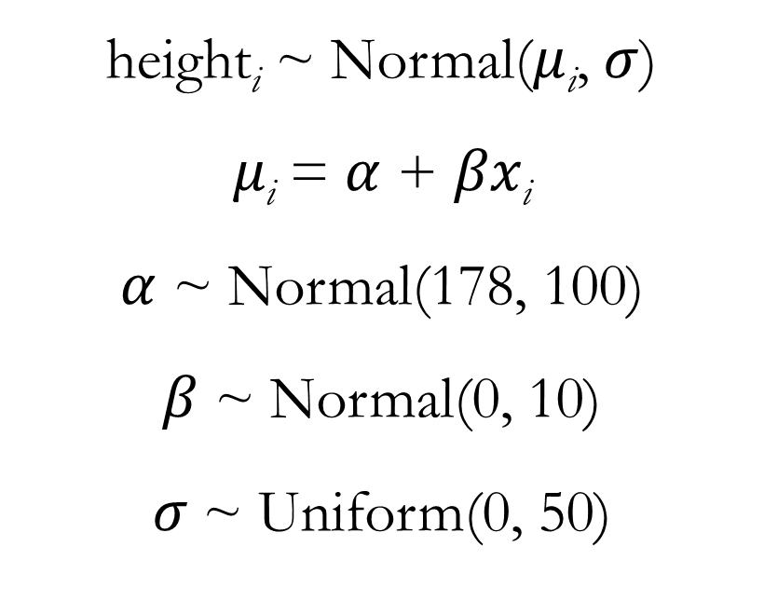
Gaussian Model for Height: Adding a Weight Predictor
height_{i} ~ Normal($μ$_{i}, $σ$)
$μ\text{i}$ = $α$ + $βx\text{i}$
$α$ ~ Normal(178, 100)
$β$ ~ Normal(0, 10)
$σ$~ Uniform(0, 50)

Slide 16
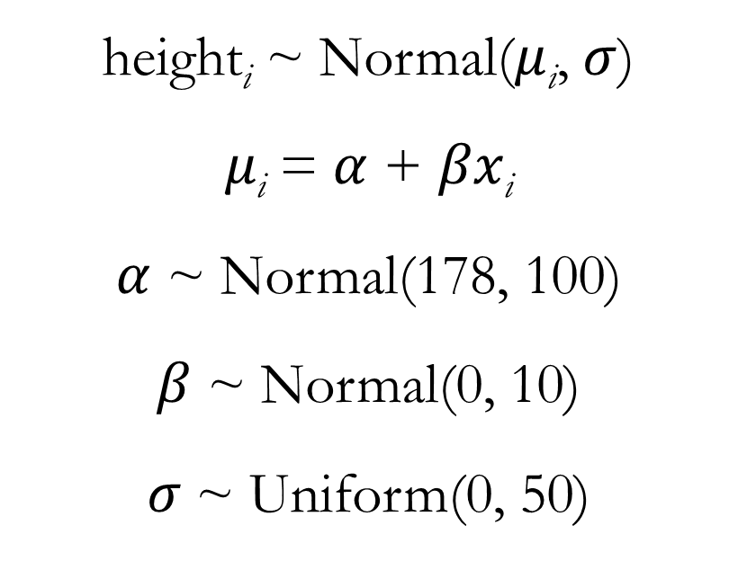
Gaussian Model for Height: Adding a Weight Predictor
height_{i} ~ Normal($μ$_{i}, $σ$)
$μ\text{i}$ = $α$ + $βx\text{i}$
$α$ ~ Normal(178, 100)
$β$ ~ Normal(0, 10)
$σ$~ Uniform(0, 50)
This is a deterministic relationship. It is the mathematical way of describing a line!

Slide 17
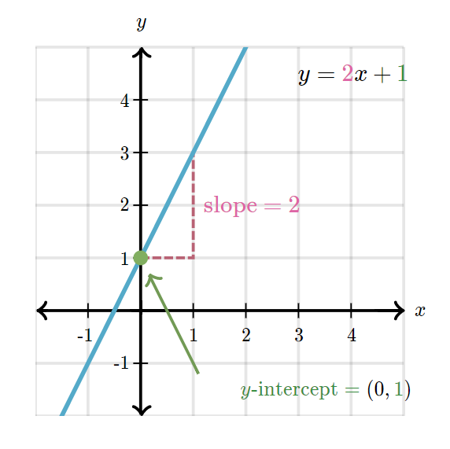
Intercept and slope

Slide 18
Interpretation of Slope Parameters
Slope parameter:
quantifies the strength of a predictor’s influence on the outcome
posterior mass >0 indicates a positive effect, posterior mass <0 indicates a negative effect, posterior mass overlapping 0 indicates lack of an effect
It often makes sense to use a prior for slope that is centered at 0
Notes:
Show lecture code

Slide 19
Gaussian Model for Height: Adding a Weight Predictor
model <- quap(
data = kungdata,
alist(
height ~ dnorm(mu, sigma),
mu <- a + b*weight,
a ~ dnorm(178, 100),
b ~ dnorm(0, 10),
sigma ~ dunif(0, 50)
))

Slide 20
Gaussian Model for Height: Adding a Weight Predictor
Important (!) Notes
Mean (mu): Mean is now modeled indirectly via the intercept and slope parameters
Intercept (a): Expected mean outcome when the predictor has a value of 0
Slope (b): Expected increase in the mean of the outcome for each one unit increase in the predictor
See lecture code

